Slide 1
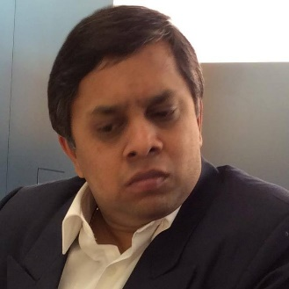
Know Your Trainer: Guru [Gurumurthy ]
Director – GS3 Software Pvt. Ltd.
  Your Trainer - Guru
  Oracle Certified J2EE Architect (Level 1)
  https://www.linkedin.com/in/gurumurthy-ramamurthy-7864738/
  Experience:
  29 years in IT field
  16+ years in IT development and 12+ years in Training
  ORACLE India - worked as PMTS (Principal Member Technical Staff) for about 6 yrs.
  Some of other companies I worked are IBM, CSC, Convansys, KLETT, MERC
  Done 600+ corporate trainings in 5 countries (India, Mexico, USA, Phil, Poland, Germany, Morocco, Ethiopia)
  My areas of expertise: Data Structures and Algorithms, Oracle DB, Oracle DB version 23, SQL, PLSQL, utPLSQL, NoSQL, Unix/Linux, MongoDB, GoLang, Erlang, Cassandra, GraphDB/neo4j, Python, Speech Recognition, Django, Java (JDK 8, 9, 10, 11, 12, 13, 14), Advance Java, Kotlin, JDBC, ORM, JPA, Tomcat, WebLogic, ORM, JPA, EclipseLink, Hibernate, JUnit, TestNG, Mockito, Golang, Golang Testing, Erlang, Selenium, SonarQube, Jacoco, Cucumber, Jasmine, J(2)EE, EJB, JMS, XML, ANTLR, XSLT, XQuery, XPath, XSD, oXygen, JavaScript, TypeScript, Unix Shell Scripting, Java Core Design Patterns, J(2)EE Patterns, Logging, Web Fundamentals (HTML, CSS, JS), Frameworks (Spring, Spring MVC, Spring Security, Spring Boot, Struts, JSF, ICEFaces, PrimeFaces, Eclipse, IntelliJ, Android Studio, Hibernate, JPA, Microservices, Netflix / orkes conductor, Eureka, Zuul), Web Services (SOAP, REST), UI Development (HTML5, CSS3, JavaScript,BootStrap) jQuery, AngularJS, Angular, Angular versions 6,11,17, Node-RED, NodeJS, Express JS, Selenium, WebDriver, Robot framework, JMeter, VueJS, React, ReactNative, Micro Frotend using React, Micro Frontend using Angular, FLUTTER, Apache Cordova, KnockoutJS, OJET, Vue, Bootstrap, BI, Tableau, Power BI, ELK Stack (ElasticSearch, Logstash, Kibana), ANT, Maven, Gradle, Perl, CGI Perl, Unix Shell scripting, REDIS, DevOps, CI/CD, Jenkins, Scala, Kafka, Spark, Hadoop, Hive, DevOps, Docker, Kubernetes, Profiler, Google Cloud Platform, AWS, Azure, AI.

Slide 2
Prestigious clientele
Oracle, OU, OFSS (India, USA, Japan)
Microfocus (India, USA) / OpenText
_{UST Global – IN, US, Mexico}
_{CFG Bank, Casablanca, Morocco}
Dashen Bank, Addis Ababa, Ethiopia
_{MERCEDES BENZ}
_{AMAZON}
_{JP Morgan}
_{SAP}
_{IBM}
_{L & T}
_{E & Y}
_{Siemens (NodeJS)}
_{Deloitte}
_{PAYTM}
_{PAYPAL}
_{PWC (Price Water Coopers)}
_{FlipKart}
_{SAPIENT}
_{TCS}
Harman
Profinch
DXC
Societe Generale (French based)
Siemens
IEEE - USA
Mahindra comviva
CTS
Vodafone
Lowe’s
Thoughtfocus
Nous Infosystems
XMPLAR
Optum Global Solutions
Pratham Software
Mobily Infotech
AutoLiv

Slide 3
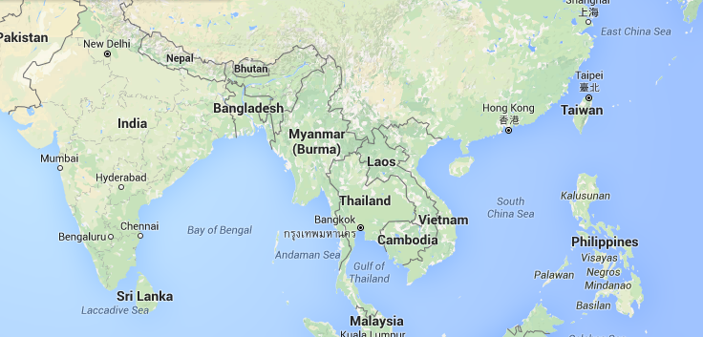
Where I am located in World Map?

